Slide 1

Go Fish! The Important Factors in Population Management for Atlantic Cod in the Northeast Continental Shelf
MSBA 6120 - Statistics for Data Science
Yali (Lydia) Li, Dimo Liao,
Lauren Moore, Anupam Shandilya

Slide 2
Agenda
Introduction
Motivation
Project Goal
Meet the Fish
Data Used
Regression Analysis
Final Thoughts

Slide 3
Introduction

Slide 4
Motivation
The FAO estimated that from 1990 to 2007, about 1/4 of ﬁsh stocks were overexploited, depleted, or recovering from depletion
In 1852 the biomass of Atlantic cod was about 1,260,000 metric tons
As of 2005, the biomass of Atlantic cod has been estimated to be 50,000 metric tons

Slide 5
Motivation
NEFSC is a part of the National Oceanic and Atmospheric Administration (NOAA)
Lab is located in Woods Hole, MA
Manage research on marine resources and habitat quality of the Northeast Continental Shelf ecosystem
Provide options for balancing marine resource use and conservation

Slide 6
Project Goal
To determine which predictors influence the biomass of the
Atlantic cod in the Northeast Continental Shelf in the fall.

Slide 7
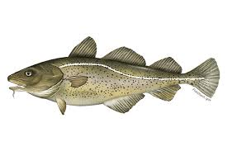
Meet the Fish
Atlantic Cod:
Primary fish of interest
Overfished
Consume Atlantic Herring

Slide 8
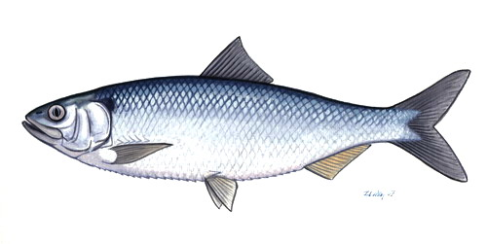
Meet the Fish
Atlantic Herring:
Above target population
Consumed by Atlantic Cod and Silver Hake

Slide 9
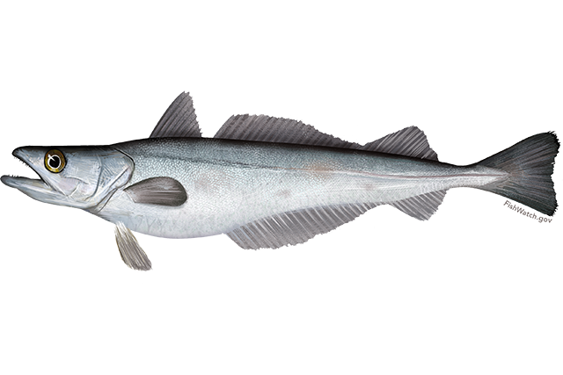
Meet the Fish
Silver Hake:
Above target population
Consume Atlantic Herring

Slide 10
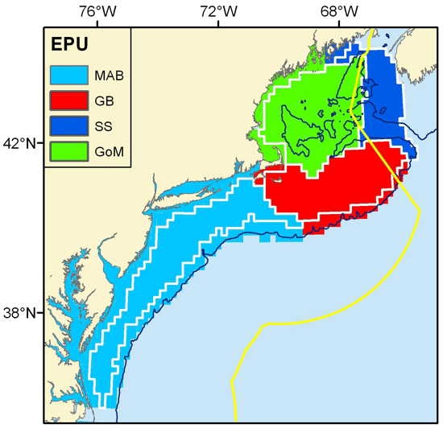
Data Provided
From 1968 to 2013
640 different stations
Data Measured:
Biomass
Temperature
Depth of trawl

Slide 11
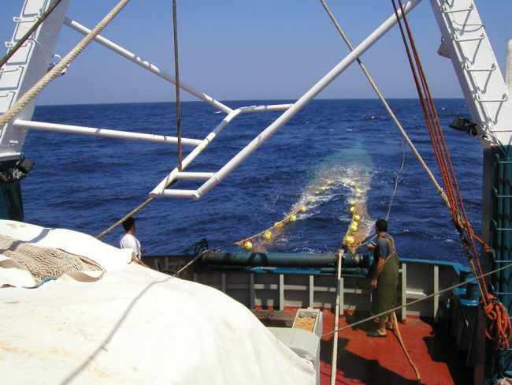
Data Collection
Bottom Trawl Survey
Collects data every 6 months
Goes to a randomly selected strata
Drag net for 20 min
Sort fish by species
Collect data

Slide 12

Data Provided
mass_c | Total biomass of cod | Kilograms
mass_h | Total biomass of herring | Kilograms
mass_ha | Total biomass of silver hake | Kilograms
b_temp | Temperature of ocean at depth of trawl | Celsius
s_temp | Temperature of ocean surface | Celsius
depth | Depth of trawl | Meters

Slide 13
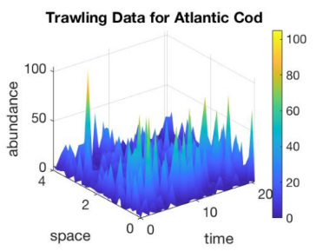
from 1980 through 2000 in Georges Bank

Slide 14
Regression Analysis

Slide 15
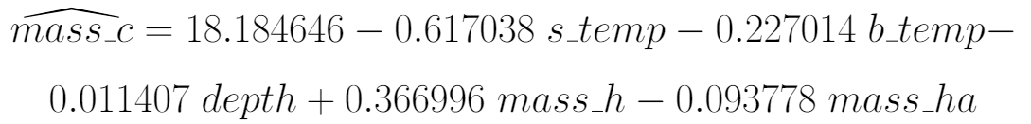
Full Model
Advantages:
All predictors are meaningful
Statistical value:
Very small chance of obtaining a sample more
extreme than the actual sample value, given
there is no relationship

Slide 16
Full Model
Disadvantages:
No practical value:
9.581% of the variation is explained by the model.
Not a simple model

Slide 17
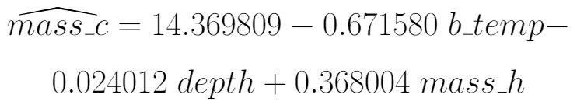
Simplified Model
Advantages:
All predictors are meaningful
Statistical value:
Very small chance of obtaining a sample more
extreme than the actual sample value, given
there is no relationship

Slide 18
Simplified Model
Disadvantages:
No practical value:
8.721% of the variation is explained by the model.

Slide 19
Comparing the Models
 | Full Model | Simplified Model
mass_h | 0.366996 | 0.368004
b_temp | -0.227014 | -0.671580
depth | -0.011407 | -0.024012
R^2 | 0.09581 | 0.08721
No significant difference between the models

Slide 20
Final Thoughts

Slide 21
Key Takeaways
Models provided evidence of a relationship between the biomass of Atlantic cod and -
Atlantic herring
Bottom temperature at time of trawl
The depth of trawl

Slide 22
Key Takeaways
Normality assumptions do not hold
Other models such as Lotka-Volterra
(predator - prey model) may be better for predicting the biomass of Atlantic cod

Slide 23
Thanks!
Questions?

Slide 24
Sources
[0] S. Amato, L. Moore, K. Ragosta, and S. Stowe, “Modeling the Spatio-Temporal Dynamics of Interacting Fish Species in the Northeast Continental Shelf,” pp. 1 - 7, 2018. (In process of being published).
[1] J. Beddington, D. Agnew, and C. Clark, “Current Problems in the Management of Marine Fisheries,” Science, vol. 316, no. 5832, pp. 1713 – 1716, 2007.
[2] “Atlantic Cod,” https://www.fisheries.noaa.gov/species/atlantic-cod, 2018.
[3] A. Myers, N. Hutchings, and N. Barrowman, “Hypotheses for the decline of cod in the North Atlantic,” Marine Ecology Progress Series, vol. 138, no. 293-308, 1996.
[4] “Silver Hake,” https://www.fisheries.noaa.gov/species/silver-hake, 2019

Slide 25
Sources
[5] “Atlantic Herring,” https://www.fisheries.noaa.gov/species/atlantic-herring, 2019
[6] P. Politics, J. Galbraith, P. Kostovick, and R. Brown, “Northeast Fisheries Science Center Bottom Trawl Survey Protocols for the NOAA Ship Henry B. Bigelow,” 2014, Northeast Fisheries Science Center Reference Document.
[7] H. Bigelow and W. Schroeder, Fishes of the Gulf of Maine. US Government Printing Office, 1953, vol. 53.
[8] M. Morin, “Movement of Atlantic Cod in And Among the Western Gulf of Maine Rolling Closures as Determined Through Mark and Recapture,” Master’s thesis, University of New Hampshire, 2000.

